Slide 1
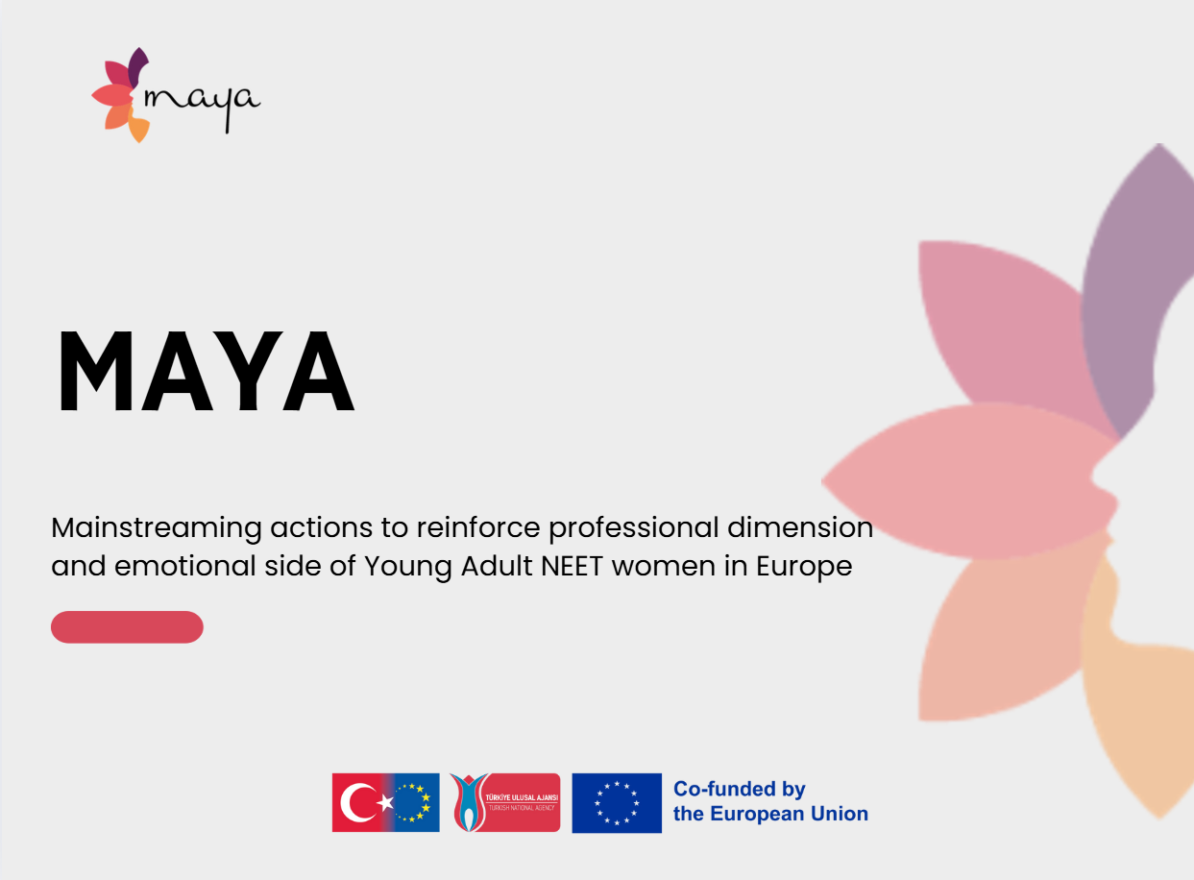
Work package 3 - MAYA Open Interactive Education Resources: mentoring program, training curriculum, interactive tools
Training Curriculum

Slide 2


Introduction to the MAYA Project
The MAYA Project: Empowering Young Women Through Montessori Training has been designed to support disadvantaged young women, particularly those who are not in education, employment or training (NEET). By adapting Montessori principles for adult learning, the project promotes personal development, social inclusion and professional growth. This learner-centred approach emphasises respect, autonomy, and emotional support, encouraging active participation in the learning process.
Target group
The MAYA Training Curriculum primarily targets youth workers, adult educators, trainers and other professionals who work directly with disadvantaged young women, particularly those classified as NEET (Not in Education, Employment or Training). These professionals play a key role in helping young women to return to education, develop essential life skills and prepare for the labour market.
The secondary target group comprises policymakers, NGOs, community organisations and training centres that can incorporate the curriculum into their programmes to ensure a broader impact.
.

Slide 3
The Role of the Consortium and the Importance of the Curriculum
The MAYA consortium comprises partners from Turkey, Austria, Portugal and Italy who have diverse expertise in adult education, youth empowerment and social inclusion. Each country brings unique perspectives and best practices: Turkey has strong experience in youth engagement; Austria has expertise in curriculum development and project management; Portugal has innovative approaches to community learning; and Italy has valuable knowledge of applying Montessori principles to adult contexts.
This multinational collaboration ensures that the curriculum is academically sound and practically relevant in different socio-cultural environments. The consortium's collaborative efforts enrich the curriculum, making it adaptable and inclusive for disadvantaged young women in Europe.

Slide 4
The Role of the Consortium and the Importance of the Curriculum
The training curriculum plays a central role in the MAYA Project, serving as the main educational tool that transforms project goals into practical impact. It provides a common framework for training across all partner countries;
ensures quality, consistency and transferability of methods;
adapts Montessori-inspired approaches to adult learning contexts; and
forms the basis of the Guide for Personalised Learning, which helps trainers to tailor education to individual needs.
creates a sustainable resource that can be used beyond the project’s lifetime.
Through this curriculum, consortium partners in Türkiye, Austria, Portugal and Italy empower youth workers and young women together, ensuring the project contributes to inclusive education, equal opportunities and long-term social change.
.

Slide 5
Introduction to the MAYA Training Curriculum
The curriculum consists of seven comprehensive modules, each covering a key aspect of Montessori-inspired adult learning.
1.Personalisation and Co-Design of Education; Observational Learning
2.Participatory Approach and Communities of Learners
3.Intellectual Stimulation of Young Adult Learners
4.Development of the Senses and Tactile Approach; Involving Technologies
5.Emotional Intelligence and Social-Emotional Learning
6.Monitoring Progress – Observation and Assessment of Adult Learner
7.Creation of a Personal Educational Plan
Together, these modules form a comprehensive training programme that provides youth workers with innovative tools and methods and empowers young women to take charge of their learning journeys. By engaging with this curriculum, educators and learners will contribute to more inclusive education and equal opportunities in the labour market across Europe.
.

Slide 6
Introduction to the MAYA Training Curriculum
This training curriculum is one of the project's main outputs. It has been developed for youth workers, trainers and other professionals who work with young women facing barriers to education and employment. The curriculum provides these professionals with structured content, practical tools, and innovative methodologies to engage NEET women in meaningful and empowering learning experiences. Combining theory and practice, it offers both face-to-face and digital resources.
It is intended for implementation in various learning environments, such as community centres, vocational training settings, non-formal education contexts and blended learning platforms. It aims to:
equip educators with methods to create learner-centred, participatory sessions;
support young women in building confidence, autonomy and transferable skills;
encourage personalised learning pathways adapted to each learner’s needs;
promote social and emotional growth and community involvement.

Slide 7
How to use the curriculum
The curriculum is designed to be flexible and adaptable, so that trainers and organisations can implement it in a variety of contexts.
Non-formal education settings: Youth centres, NGOs and community projects can use the modules to organise workshops and training sessions.
Vocational training programmes: Trainers can integrate specific modules (e.g. Personal Educational Plan and Emotional Intelligence) into existing VET courses to support employability.
Blended learning environments: The curriculum can be used for both face-to-face and online learning, combining interactive activities with digital tools.
Individual coaching and mentoring: Trainers can use the personalised learning guide to create bespoke learning pathways for each learner.

